Slide 1
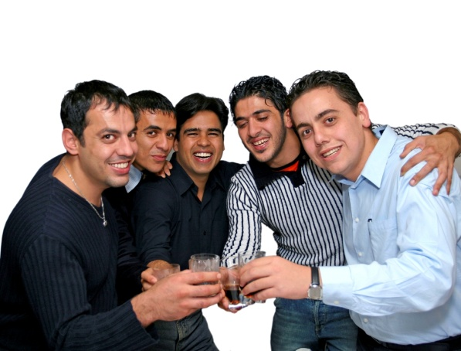
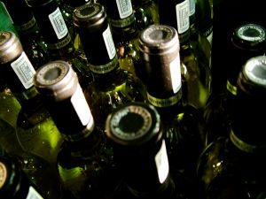
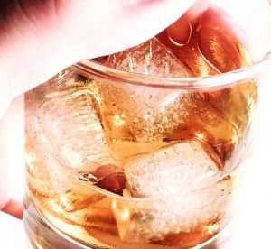
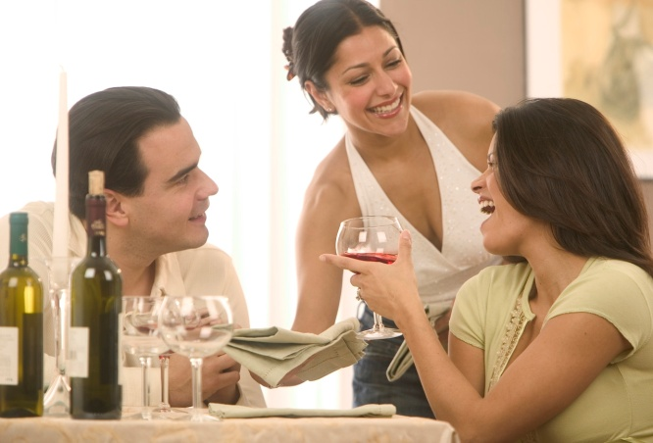
Manage intoxicated persons
D1.HBS.CL5.17 D1.HSS.CL4.07
Notes:
Trainer welcomes trainees to class and informs them that the unit “Manage Intoxicated Persons” will be presented.

Slide 2
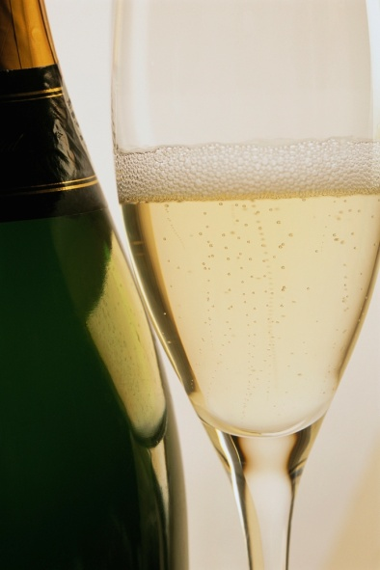
Subject Elements
This unit comprises three Elements:
Determine the level of intoxication
Apply appropriate procedures
Comply with legislation.
Notes:
Trainer advises this Unit comprises three Elements, as listed on this slide explaining:
• Each Element comprises a number of Performance Criteria which will be identified throughout the class and explained in detail
• Trainees can obtain more detail from their Trainee Manual
• At times the course presents advice and information about various protocols but where their workplace requirements differ to what is presented, the workplace practices and standards, as well as policies and procedures must be observed.

Slide 3
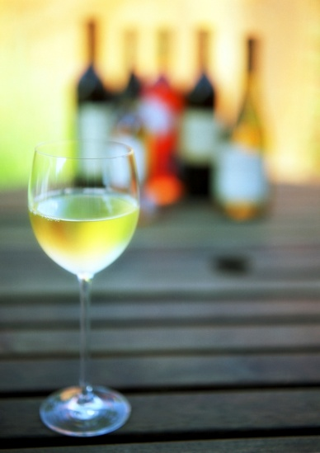
Assessment
Assessment for this unit may include:
Oral questions
Written questions
Work projects
Workplace observation of practical skills
Practical exercises
Formal report from supervisor.
Notes:
Trainer advises that assessment for this Unit may take several forms all of which are aimed at verifying they have achieved competency for the Unit as required.
Trainer indicates the methods of assessment that will be applied to them for this Unit.

Slide 4
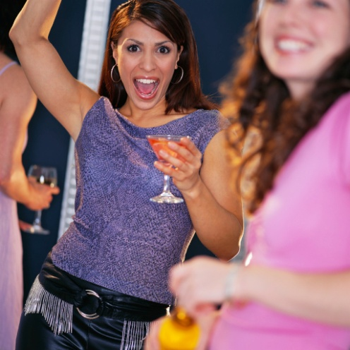
Element 1:
Determine the level of intoxication
Notes:
Introduce topic.
Class Activity – General Discussion
Ask general questions:
What is intoxication?
What causes intoxication?
What is an acceptable level of intoxication?
How do you handle someone who is intoxicated?

Slide 5
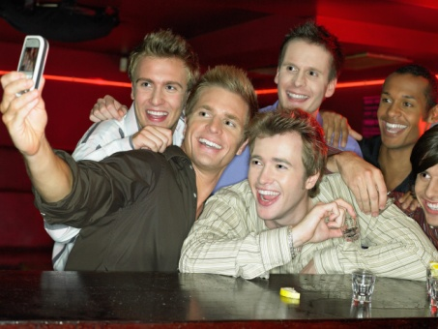
Determine the level of intoxication
Performance Criteria for this Element are:
Assess intoxication levels of customers
Offer assistance to intoxicated customers politely
Refer difficult situations to an appropriate person within or outside of the establishment
Seek assistance from appropriate people for situations which pose a threat to safety or security of colleagues, customers or property.
Notes:
Trainer identifies the Performance Criteria for this Element, as listed on the slide.

Slide 6
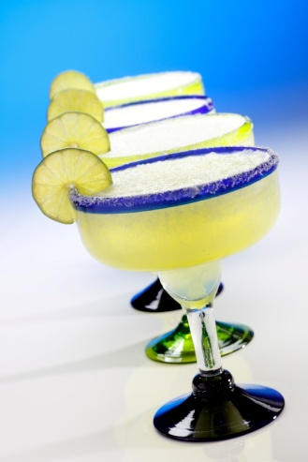
Alcohol
Many hospitality venues serve alcohol in their various food and beverage outlets
It is part of most cultures that alcohol is served, with or without meals
Whilst for the most parts customers are able to enjoy themselves and drink in a responsible manner, this is not always the case.
Notes:
Class Activity – Questions
What types of venues serve alcohol?

Slide 7
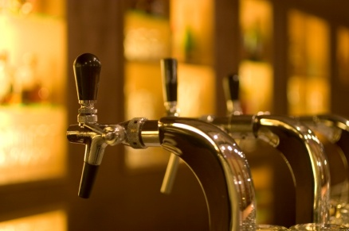
Alcohol
The purpose of this subject is to enable hospitality staff to:
Understand the legal implications when serving alcohol
Understand their responsibilities in relation to the service of alcohol
Handle situations where people are intoxicated.
Notes:
Class Activity – Questions
What are some legal implications when serving alcohol?
What are some management and staff responsibilities in relation to the service of alcohol?
How do you handle situations where people are intoxicated?

Slide 8
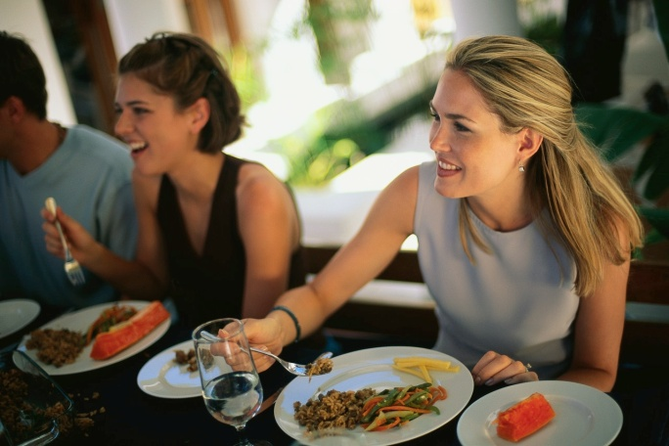
Duty of care
The primary responsibility a business has is to ensure the health and safety of those who either:
Frequent an establishment or
Are impacted due to its existence.
Notes:
Class Activity – Questions
Who is impacted by a business?

Slide 9
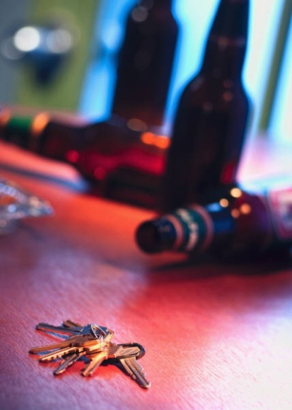
Duty of care
Managers and staff have a duty of care to make sure that all people are safe from harm when:
On the premises
When they leave.
Notes:
Class Activity – Questions
Does a business need to care what happens when drunk people leave the premises?
Think about a night club and the movement of patrons after they have left. What potential problems exist?
How can you ensure an adequate duty of care?

Slide 10
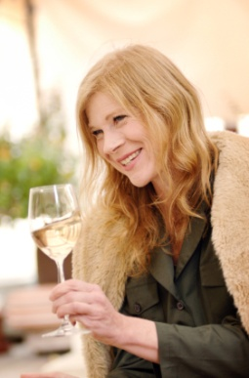
Duty of care
This duty of care is owed to all people in the environment including:
Customers
Owners
Managers
Staff
General Public.
Notes:
Class Activity – Questions
How can you provide a duty of care to each of these people mentioned in the slide?

Slide 11
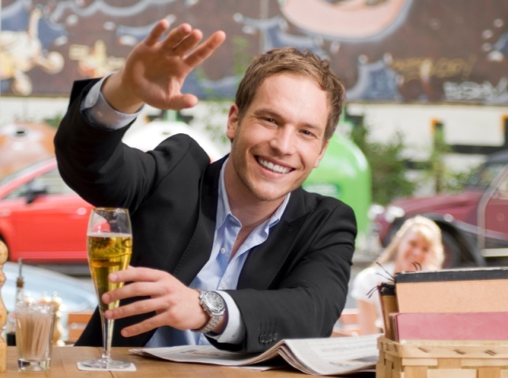
Responsible service of alcohol
Every organisation must promote the responsible service of alcohol.
What is it?
How do you do it?
Notes:
Class Activity – Questions
Answer the questions in the slide.

Slide 12

Responsible service of alcohol
Benefits to the business:
Increase to reputation
Reduces fines and liability
Allows a business to remain operational
Increased business and profits as people feel comfortable visiting your establishment
Less likely to have damage to the premises due to breakages, spillage, vomit.
Notes:
Class Activity – Discussion
Discuss the benefits.

Slide 13
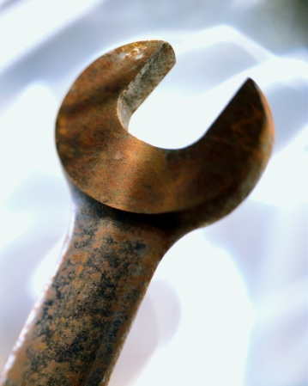
Responsible service of alcohol
Benefits to the business:
Reduced costs to repair broken items
Create disorder and ruin the ambience of a venue
Reduces staff costs as less staff are required to handle drunk patrons
Reduced liability and insurance
Reduced legal claims.
Notes:
Class Activity – Discussion
Discuss the benefits.

Slide 14

Responsible service of alcohol
Benefits to staff:
Less stress for staff
Less potential harm or threatening actions
Enables easier communication with customers
Less work for staff
Creates a safe and harmonious work place for all staff and customers
Increases job satisfaction and security.
Notes:
Class Activity – Discussion
Discuss the benefits.

Slide 15
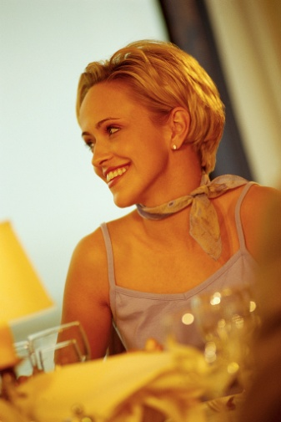
Responsible service of alcohol
Benefits to customers:
Reduces chance of customers hurting themselves or others
Allows the atmosphere and experience of fellow customers to be positive
Reduces violent or threatening behaviour
Reduces crimes and domestic violence
Reduces drink driving which is a leading cause of road and pedestrian accidents.
Notes:
Class Activity – Discussion
Discuss the benefits.

Slide 16
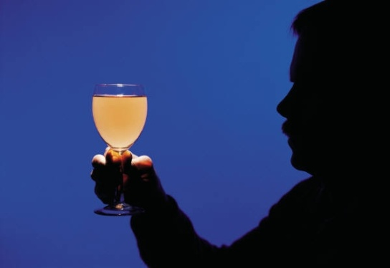
Alcohol
Alcohol is a substance that has become an everyday part of society
However what it is and how it affects the body is often not discussed.
Notes:
Class Activity – Questions and Tour of bar
What is alcohol?
How is it made?
The trainer should take the audience to a bar or to a location that has a large variety of alcoholic beverages.
What types of alcoholic drinks are there?

Slide 17
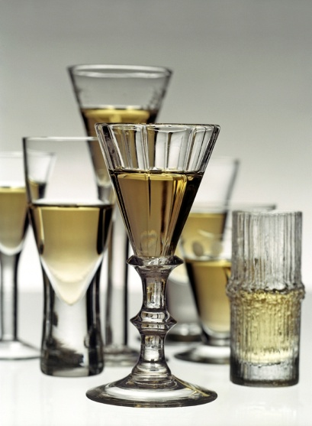
Alcohol
The intoxicating ingredient in alcoholic beverages is known as ethyl alcohol or pure alcohol
This ingredient is contained in all alcoholic drinks
However the level of concentration differs between drinks.
Notes:
Class Activity – Questions
Which alcoholic drinks are stronger than others?
Why is this the case?

Slide 18
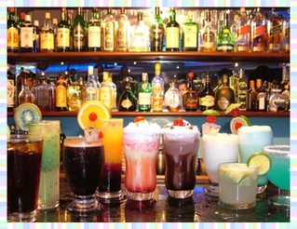
Alcohol
In order to make measurement as uniform as possible, the agreed convention for standardizing drinks is ‘grams of pure alcohol’.
Notes:
Class Activity – Questions
Why is it important to have a standard measure for alcohol?

Slide 19
Alcohol by volume
Different drinks will also have some different strengths.
This is referred to as ‘alcohol by volume’.
Examples include:
Beer: normally 3 – 5 %
Wine: normally 12 – 14%
Spirits: normally 37 – 43%.
Notes:
Class Activity – Questions
What is the ABV of other alcoholic drinks?

Slide 20
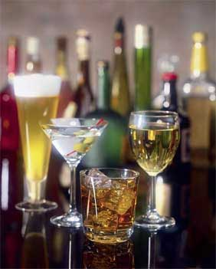
Standard drink
A “standard” drink will always contain a given amount of pure alcohol, regardless of whether it is beer, wine or spirits.
Notes:
Class Activity – Questions
What is the volume for a standard drink? (This will change depending on the drink)

Slide 21
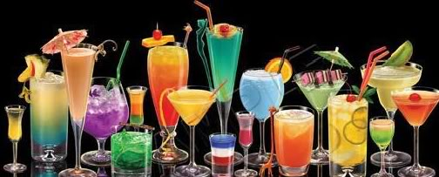
Standard drink
A standard drink is commonly defined as a beverage that contains 10 grams of pure alcohol
This may vary between 8 and 14 grams in different countries
Some countries do not identify a ‘standard drink’.
Notes:
Class Activity – How many standard drinks?
The trainer should show or write down a range of different drinks and get the audience to guess how many standard drinks are in each beverage.

Slide 22
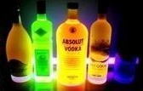
Standard drink
As a general rule, a standard drink can be defined as:
30 mls of sprits
285 mls of full strength beer
100 mls of wine.
Notes:
Class Activity – How many standard drinks?
How many drinks actual come as a ‘standard drink’?
Which do?
Which don’t?

Slide 23
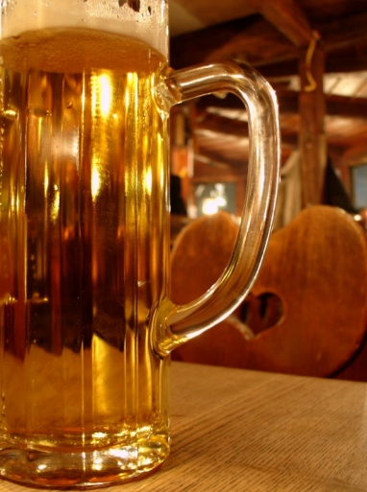
Standard drink
In reality, most alcoholic drinks are not served as a neat ‘standard drink’
The size of the glass and pouring size may mean a drink contains more than 1 standard drink or 10 grams of alcohol.
Notes:
Class Activity – How many standard drinks?
How many standard drinks are there in average size drinks?

Slide 24
Standard drink
For example:
A 330ml bottle of beer (5% ABV) may contain 13.2 grams of alcohol / 1.3 standard drinks
A 200ml glass of wine (12% ABV) may contain 19.2 grams of alcohol / 1.9 standard drinks
A 568ml (pint) of beer (4% ABV) may contain 18.2 grams of alcohol / 1.8 standard drinks.
Notes:
Class Activity – How many standard drinks?
How many standard drinks are there in other average size drinks?

Slide 25
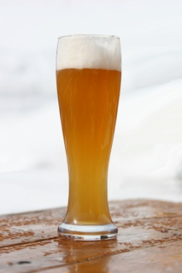
Determining ‘standard drink’
A formula for working out how many grams of alcohol / standard drinks in a beverage is:
{Amount of drink (ml) X Strength of drink (ABV)} x 8
1000
Notes:
Class Activity – How many standard drinks exercise
Based on this formula, trainer should get the audience to determine how many standards of drinks are in a range of alcoholic beverages.

Slide 26
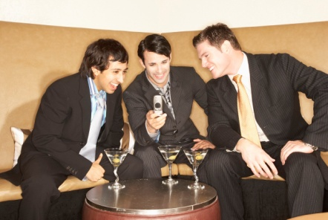
Effects of alcohol
Many people enjoy visiting hospitality organisations as it provides a chance for people to relax, unwind and enjoy themselves through the provision of good food, beverage and entertainment.
Why do people drink alcohol?
What effects does it have?
Notes:
Class Activity – Questions
Answer the questions in the slide.

Slide 27
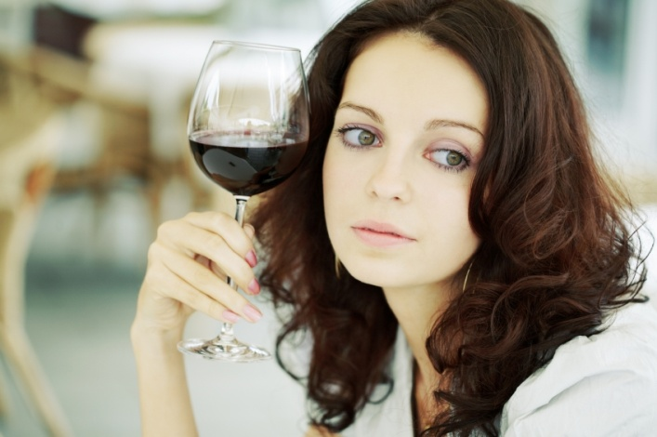
Effects of alcohol
It is still important to remember that alcohol:
Depresses the brain’s functions
Which leads to changes in a person’s behaviour.
Notes:
Class Activity – Questions
What changes in behaviour take place?
How does alcohol change your behaviour?

Slide 28
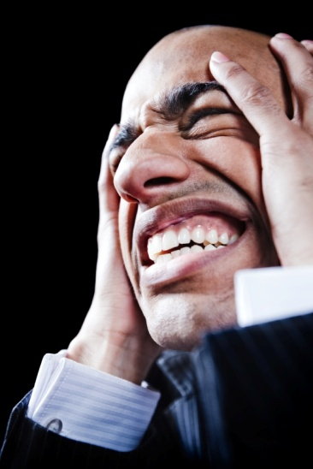
Effects of alcohol
When consumed in an irresponsible manner alcohol can become a:
Dangerous and damaging substance
Which can have serious effects on a person.
Notes:
Class Activity – Questions
What does ‘irresponsible’ mean?

Slide 29
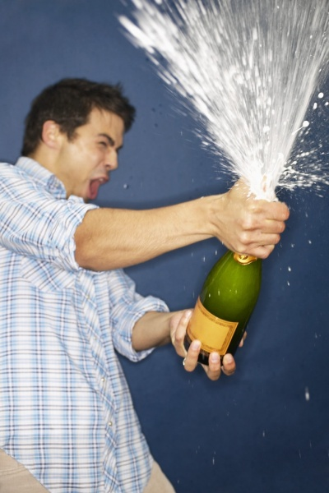
Effects of alcohol
Therefore as a staff member within the hospitality industry, it is important that you ensure customers:
Consume alcohol in a sensible manner
Understand the effect alcohol has on people.
Notes:
Class Activity – Questions
How can you ensure customers:
Consume alcohol in a sensible manner?
Understand the effect alcohol has on people?

Slide 30

Alcohol and the body
Alcohol entering body
Alcohol, when consumed it is normally swallowed and goes into the stomach
The stomach breaks down food and drink before passing it to the small intestine
It is then absorbed into the bloodstream
The less food eaten, the quicker it is absorbed.
Notes:
Class Activity – Discussion
Discuss how alcohol enters the body – based on the points in the slide.

Slide 31
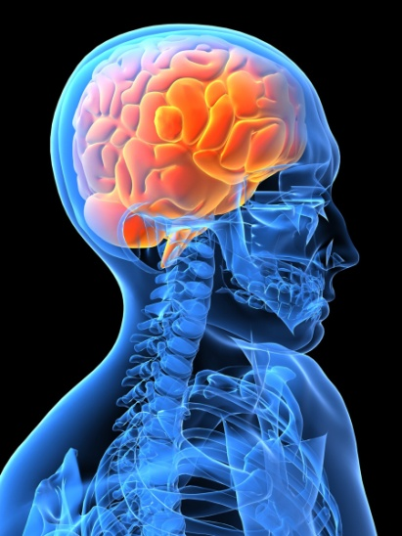
Alcohol and the body
Alcohol entering body
The bloodstream then carries the alcohol to the brain
This process takes about 5 minutes
It starts to affect the function of the brain including:
Judgement
Inhibitions.
Notes:
Class Activity – Discussion
Discuss how alcohol enters the body – based on the points in the slide.

Slide 32

Alcohol and the body
Alcohol entering body
As more alcohol is absorbed, it continues to travel to other parts of the body affecting other functions including:
Balance
Co-ordination
It is this effect that starts to make us appear to be drunk.
Notes:
Class Activity – Discussion
Discuss how alcohol enters the body – based on the points in the slide.

Slide 33

Alcohol and the body
Alcohol affects people differently
In essence, alcohol affects different people in different ways due to:
Speed of drinking
Strength of drink
Person’s sex
Person’s weight
Amount of food eaten
Tolerance to alcohol.
Notes:
Class Activity – Discuss why alcohol affects people differently
Speed of drinking
Strength of drink - the blood alcohol concentration (BAC)
Person’s sex - women are more affected than men
Person’s weight - a small person is more affected than a big person
Amount of food eaten - a person who has empty stomach is more affected than a person who has eaten a big meal
Tolerance to alcohol - a person who drinks rarely will appear more affected than a person who drinks regularly.

Slide 34

Monitoring intoxication
As a staff member, it is important to:
Know the early symptoms of intoxication
Refuse to serve such customers well before they become obviously drunk.
Notes:
Class Activity – Questions
Why is this role of staff members to monitor?
What consequences exist for the organisation and individual staff members if patrons become intoxicated?

Slide 35
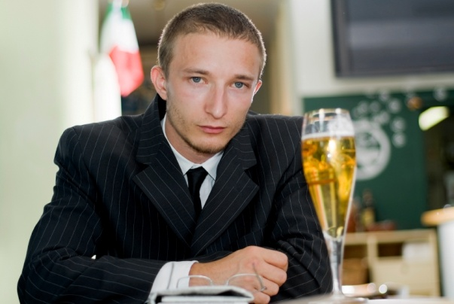
Monitoring intoxication
As alcohol consumption increases it:
Worsens customer’s physical and mental functioning
Makes them less likely to be able to make decisions about their own well being.
This is why it is up to the server to decide who has had enough to drink, not the drinking customer.
Notes:
Class Activity – Questions
As a staff member when should you decide a customer has had enough to drink?
How do you approach this with the customer?

Slide 36
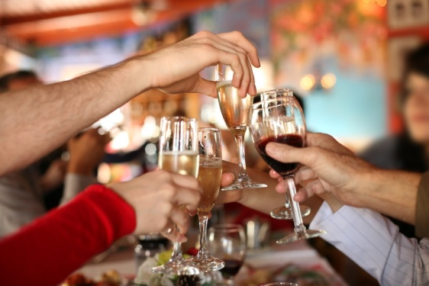
Intoxication
What is intoxication?
Different countries will prohibit the sale or supply or alcohol to someone who appears to be intoxicated or drunk.
By what does this mean?
When do you know someone has reached this level?
Notes:
Class Activity – Questions
Answer the questions in the slide.

Slide 37
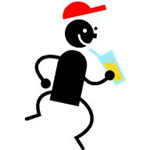
Intoxication
What is intoxication?
In summary, “intoxicated” is the body’s response to having alcohol in the human system
This is always hard to identify so what signs exist that may indicate intoxication?
Notes:
Class Activity – Questions
What are signs of intoxication?

Slide 38

Signs of intoxication
Loss of coordination
Being clumsy
Eyes seem unfocused or glassy
Bumping into furniture and other people
Staggering
Falling down or tripping over things
Inability to walk in a straight line
Inability to do basic tasks like lifting a glass
Knocking things over.
Notes:
Class Activity – Discussion
Discuss these signs of intoxication
How do you spot them?
Are they easy to identify?

Slide 39
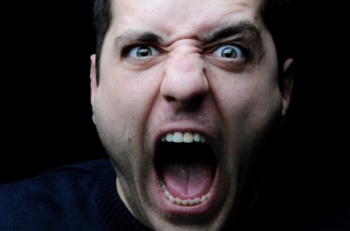
Signs of intoxication
Change in speech
Having trouble talking in a normal manner
Speech becomes slower and slurred
Volume of speech becomes louder
Person becomes outspoken.
Notes:
Class Activity – Discussion
Discuss these signs of intoxication
How do you spot them?
Are they easy to identify?

Slide 40

Signs of intoxication
Moods, behaviour and conduct
Big changes in mood over time
Personality changes
Becoming isolated from group
Inappropriately affectionate
Extremely outgoing
Wanting to cause arguments
Being over affectionate to strangers.
Notes:
Class Activity – Discussion
Discuss these signs of intoxication
How do you spot them?
Are they easy to identify?

Slide 41
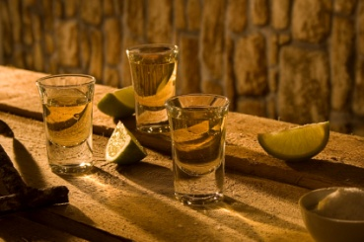
Signs of intoxication
Quantity of alcohol consumed
The amount of drinks consumed
The rate of consumption
They are ordering more drinks at a time
The types of drinks – normally become stronger
Complaints about strength of drinks.
Notes:
Class Activity – Discussion
Discuss these signs of intoxication
How do you spot them?
Are they easy to identify?

Slide 42

Signs of intoxication
Smell of alcohol
Body language.
What can you read from body language?
Notes:
Class Activity – Questions
Answer the question in the slide.

Slide 43
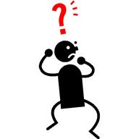
Signs of intoxication
Tool to help identify intoxication
Coordination
Alcohol Smell
Unsteady
Slurred Speech
Eyes Glazed
Notes:
Class Activity – Discussion
Discuss tool.

Slide 44
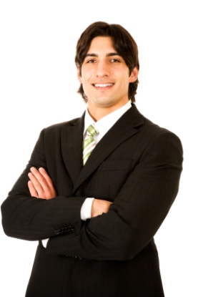
Offering assistance
When it is determined that a person is intoxicated, it is wise for staff to provide assistance where applicable
Just because someone is intoxicated does not mean they need to leave the premises
It is important to remember that each situation must be handled in a professional and discrete manner.
Notes:
Class Activity – Questions
What is determined to be acceptable levels of intoxication?
When should a person be required to leave a premises?

Slide 45

Monitoring the environment
Staff members must always be aware of the environment and alert to the consumption of alcohol by groups or individual customers within the establishment.
Notes:
Class Activity – Questions
How can you monitor the environment to ensure the level of intoxication of patrons individually or as a collective?

Slide 46

Monitoring the environment
When monitoring, be aware of:
Types of drinks being ordered
Who is ordering the drinks
Who is consuming the drinks
Rate of consumption.
Notes:
Class Activity – Questions
How can you do these monitoring steps?

Slide 47

Monitoring the environment
When monitoring, be aware of:
Whether food is also being consumed
People showing signs of intoxication
Any drinking games being conducted
Which people in the group could be of assistance when dealing with intoxicated patrons.
Notes:
Class Activity – Questions
How can you do these monitoring steps?

Slide 48

Offering assistance
There are a range of suitable alternatives that can be provided depending on the:
Individual situation
Level of intoxication.
Notes:
Class Activity – Questions
Before asking someone to leave the premises, what different types of assistance can you provide, to allow someone to stay and enjoy the venue?

Slide 49
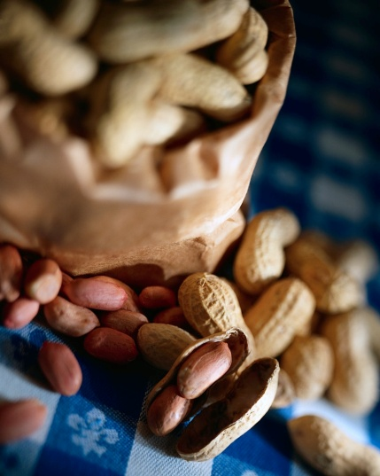
Offering assistance
Types of assistance
Talk to the customer or their friend
Briefly explain your responsibilities
Promoting non-alcoholic drinks
Offer food.
Notes:
Class Activity – Discuss types of assistance that can be provided.
Talk to the customer or their friend – this helps determine not only the level of intoxication, but how they will respond to suggestions that may be suitable
Briefly explain your responsibilities – you may wish to outline the house policy that applies, directly to the customer or a friend of theirs. Try to get the person on your side by explaining that whilst you would like the customer to stay on the premises, they must abide by the rules of the establishment
Promoting non-alcoholic drinks – most venues will have a range of soft drinks, juices or mocktails which can be a suitable alternative to alcohol
Offer food – whether through providing a menu or offering complimentary or low costs snacks such as nuts and chips.

Slide 50
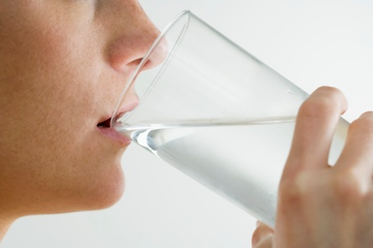
Offering assistance
Types of assistance
Offering low-alcoholic beverages
Offer water
Slowing down service
Advise other staff.
Notes:
Class Activity – Discuss types of assistance that can be provided.
Offering low-alcoholic beverages – some beverages such as beer come in a low alcoholic format which can be promoted. Alternatively half measures may be suggested when serving spirits
Offer water – water is free of charge in most facilities. You may suggest a customer having a glass of water between alcoholic drinks or for a specific period of time
Slowing down service – try to delay the service of drinks to a person, however this should not be obvious as it may frustrate the customer
Advise other staff – as to the amount of drinks the person has had or any concerns which you may have.

Slide 51
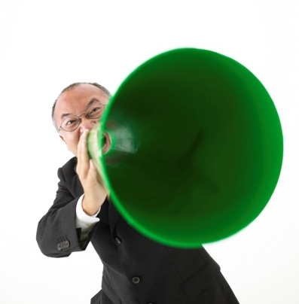
Refer matters to appropriate people
It must be remembered, that the health and safety of staff, other customers and the intoxicated person themselves is the primary objective when handling instances involving intoxication.
As customers become more intoxicated, the more difficult it may be to handle the situation yourself.
Notes:
Class Activity – Questions
What situations can you handle?
When might you wish to seek the assistance of others?

Slide 52
Refer matters to appropriate people
As a staff member, it is not a requirement for you to place yourself in harm’s way if you feel you cannot handle the situation.
You may need to get the assistance from someone:
Inside the organisation
Outside the organisation.
Notes:
Class Activity – Questions
Who would you seek assistance from:
a) Inside the organisation
b) Outside the organisation
What help would you need?
How would you contact them?

Slide 53
Refer matters to internal staff
Internal sources of assistance
These persons include:
Supervisor or Manager
Security
DJ.
Notes:
Class Activity – Discussion
Discuss the type of assistance these people can provide.
Supervisor or Manager – they will make or authorise courses of action to take
Security – they will have the expertise to deal with the manner
DJ – they have the capacity to communicate not only with different authorities but can also communicate directly to the patrons within the venue.

Slide 54
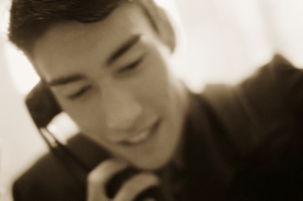
Refer matters to internal staff
Contacting internal sources
There must be an easy to use communication system to be able to notify appropriate internal people.
Systems can include:
Pagers
Signals – verbal or hand
Button
Phone call.
Notes:
Class Activity – Questions
Which is the best way to communicate?
Are there any other ways to communicate to these people?

Slide 55
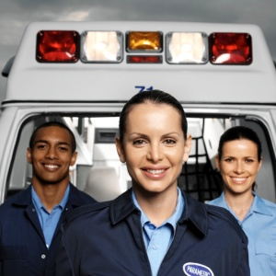
Refer matters to external sources
External sources of assistance
These persons include:
Police
Fire
Ambulance.
Notes:
Class Activity – Discussion
Discuss the type of assistance these people can provide.
Police – in the event of any activity that is breaking the law or likely to increase the risk of harm to all patrons and staff
Fire – if there appears to be a likelihood of fire
Ambulance – in the event a person requires medical assistance.

Slide 56
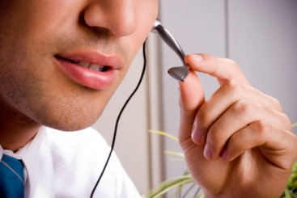
Refer matters to external sources
Contacting external sources
Easy to reach contact details can include:
Special button
Posters with contact numbers
Speed dials
Other methods that are suitable.
Notes:
Class Activity – Questions
Which is the best way to communicate?
Are there any other ways to communicate to these people?

Slide 57
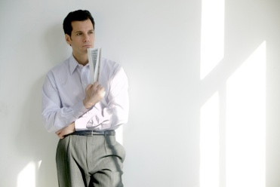
Element 2:
Apply appropriate procedures
Notes:
Introduce topic.
Class Activity – General Discussion
Ask general questions:
What are the best ways to handle intoxicated people?
Who should be responsible for doing this?

Slide 58
Apply appropriate procedures
Performance Criteria for this Element are:
Analyse situation carefully
Apply procedures appropriate to the situation and in accordance with organizational policy
Explain the position to the customer using appropriate communication skills
Assist the customer to leave the premises if necessary.
Notes:
Trainer identifies the Performance Criteria for this Element, as listed on the slide.

Slide 59

Establishing a safe venue and atmosphere
The manager plays a pivotal role in ensuring the venue is safe for all staff and patrons to enjoy.
They have control over:
What will be determined acceptable behaviour and actions within a venue
How it should be run to ensure patrons can enjoy the facility.
Notes:
Class Activity – Questions
What would you consider to be acceptable behaviour and actions?
What measures would you put into place to ensure patrons can enjoy the facility?

Slide 60
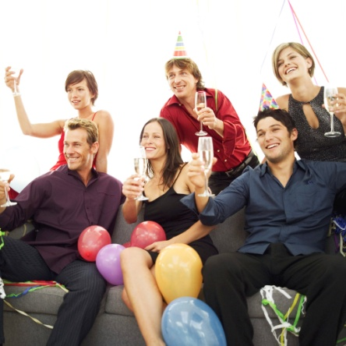
Establishing a safe venue and atmosphere
Their decisions and actions guide the atmosphere of a venue.
In essence the atmosphere is the general mood or feeling of a place.
It influences the:
Behaviour and actions of customers
The way they drink
Their ongoing behaviour.
Notes:
Class Activity – Questions
How do create a safe and responsible drinking environment?

Slide 61

Drinking behaviour
Drinking behaviour is the greatest influence on:
How each person’s behaviour and actions
The way a group interacts
The general conduct within the premises.
Notes:
Class Activity – Questions
What influences drinking behaviour?

Slide 62
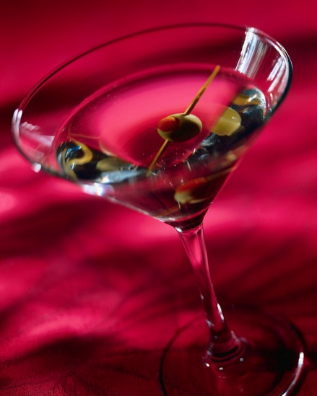
Drinking behaviour
By promoting, encouraging and controlling the drinking behaviour, it will certainly help reduce the risks associated with intoxication.
Notes:
Class Activity – Questions
What influence can management and staff have?
How can you promote drinking behaviour?
How can you encourage drinking behaviour?
How can you control drinking behaviour?

Slide 63
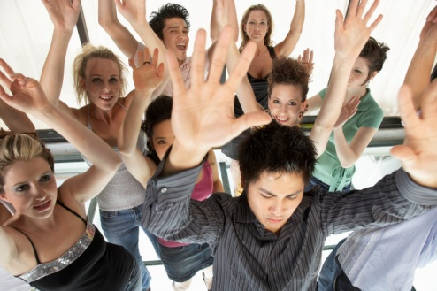
Drinking behaviour
Drinking behaviour depends on three different factors:
The drink
The drinker
The environment.
Removing or changing any one of these factors will alter the drinking behaviour.
Notes:
Class Activity – Discuss the three factors and how you can influence them?
The drink - the amount and strength of alcohol
The drinker - the characteristics of the person drinking the alcohol and his or her state of mind and personal circumstances
The environment - the atmosphere and prevailing rules of the establishment where the drinking is taking place. This could be a sports area, dancing area or a quieter dining or bistro area. The layout of the premises, whether there are more people sitting or standing, the lighting and the music are all things that create the drinking environment.

Slide 64

Creating the right environment
There are a number of factors that influence drinking behaviour and the change and degree of problems associated with intoxication.
These factors can be:
Positive
Negative.
Notes:
Class Activity – Questions
What positive factors exist?
What negative factors exist?

Slide 65

Creating the right environment
Positive factors
High levels of cleanliness
Well trained and professional staff
Facilities in operational order
Good security measures
Regular removal or rubbish and waste
Prompt cleaning of tables and removal of dirty bottles, plates and glasses
Adequate and well lit and ventilated toilets.
Notes:
Class Activity – Discuss the positive factors
What else can contribute positively when creating atmosphere?

Slide 66
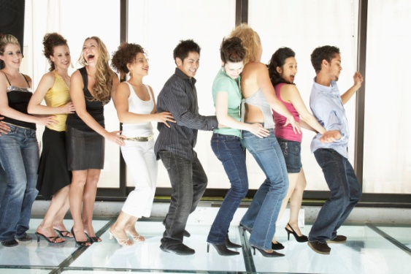
Creating the right environment
Positive factors
Non-aggressive security staff
Non-crowding policies
Mix between men and women
Good communication
Good activities
Safe venue layout
Video camera surveillance.
Notes:
Class Activity – Discuss the positive factors
What else can contribute positively when creating atmosphere?

Slide 67
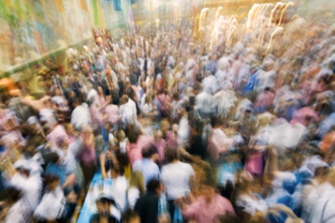
Creating the right environment
Negative factors
Unsupervised pool tables
TV showing aggressive, offensive, sexual or intoxication-related images
Offensive or sexually explicit music
Congestion
Higher percentage of customers standing
Drunk or underage persons
Vomiting.
Notes:
Class Activity – Discuss the negative factors
What else can contribute negatively when creating atmosphere?

Slide 68
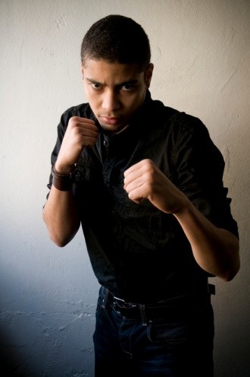
Creating the right environment
Negative factors
Drug dealing or drug use
Drunk customers in the premises
Staff being hostile or aggressive towards patrons
Staff allowing aggression or watching conflict
Staff sending people outside to fight
Late intervention in situations by staff.
Notes:
Class Activity – Discuss the negative factors
What else can contribute negatively when creating atmosphere?

Slide 69
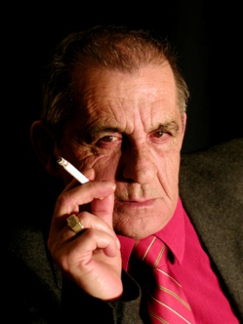
Creating the right environment
Negative factors
Patrons served double at closing time
Served after closing time
Smokiness or lack of ventilation
High level of noise and movement
Lack of bar wiping, table clearing, toilet cleanliness
Openly sexual or sexually competitive activity
In-house promotion on alcohol and “sexy dancing”.
Notes:
Class Activity – Discuss the negative factors
What else can contribute negatively when creating atmosphere?

Slide 70

Assessing the situation
Once the risks have been addressed and action taken to create the right atmosphere, this does not guarantee problems will not arise
It is vital that not only managers, but all staff constantly assess and monitor the situation as the shift unfolds.
Notes:
Class Activity – Discuss the negative factors
Why is it important to continuously monitor the situation?
Who should be doing it?
How can it be done?

Slide 71

Apply procedures
Every organisation that serves alcohol should have established policies and procedures that are in place to help promote the responsible service and consumption of alcohol.
Notes:
Class Activity – Questions
Why policies would you introduce?
What procedures would you introduce?

Slide 72

House policy
Establish a house policy
One of the most powerful ways of reducing the risks of a breach of your duty of care or local laws and regulations is to have a house policy that is:
Visible
Understood by staff and customers
Always applied.
Notes:
Class Activity – Questions
What is a ‘house policy’?

Slide 73

House policy
Establish a house policy
They contain the laws and rules of a specific organisation
It creates a framework for how an organisation will promote the safe supply and consumption of alcohol
They are often written by and unique to a venue.
Notes:
Class Activity – Questions
What should be included in a ‘house policy’?

Slide 74

House policy
Inclusions in a house policy
The following, at a minimum, should be included in a house policy:
Expected standards of behaviour of customers
A list of those not to be served alcohol
Limits for cocktails, shots or shooters.
Notes:
Class Activity – Questions
What else should be included in a ‘house policy’?
What would be different inclusions for a restaurant, bar or nightclub?

Slide 75

Signage
Most laws will require or encourage a premises to have suitable signage placed in locations that can be:
Seen by customers
Referred by staff.
Notes:
Class Activity – Questions
What signs would you have?
Where would you place them for maximum visibility?

Slide 76

Escalation Plan
It is wise to have a plan for if things get worse.
By having a plan which is understood by all staff members before an incident takes place, there is a clear path of pre-determined:
Responsibilities
Courses of action.
Notes:
Class Activity – Questions
What would you have escalation plans about? (such as fights, major injury or death of patron)
What would be some steps in these escalation plans?

Slide 77

Identify and address current issues
Drink spiking
This is where alcohol or other substances is added to drinks without the drinker’s knowledge or consent.
Notes:
Class Activity – Questions
What causes drink spiking?
Why does it take place?
Who normally does it?
Who is normally the victim?
How can a premises control or eliminate it?

Slide 78
Identify and address current issues
Drink spiking
Strategies to avoid drink spiking:
Warn customers not to leave drinks unattended
Have a policy regarding the maximum number of shots per drink
Dispose of unattended drinks
Be suspicious of orders for drinks with added shots of spirits
Look for signs that a person has become suddenly drunk
Take notice of people offering to take the affected person home.
Notes:
Class Activity – Questions
What else can you do?

Slide 79

Identify and address current issues
Binge drinking
Binge drinking is a very harmful practice of drinking too much in a short period of time or in one-off episodes.
What can you do to reduce ‘binge drinking’?
Notes:
Class Activity – Questions
Answer the question in the slide.

Slide 80

Identify and address current issues
Other issues
What other current issues exist that are related to the consumption of alcohol?
What causes them?
What risks are associated with these issues?
How can you control or eliminate these risks?
Notes:
Class Activity – Questions
Answer the questions in the slide.

Slide 81

Steps when handling intoxicated patrons
When handling intoxicated persons, there are a number of approaches that can be taken, depending on the individual situation and severity of the problem.
Regardless of the action taken, it is important for staff to:
Be professional and respectful in their approach
Conduct in a sensitive and discreet manner.
Notes:
Class Activity – Questions
What steps would you follow when handling intoxicated persons?

Slide 82

Steps when handling intoxicated patrons
The following T-A-K-E C-A-R-E steps can help resolve matters involving intoxicated patrons.
Tell early
Avoid put-downs
Keep calm
Ever courteous
Clarify refusal
Alternatives
Report
Echo.
Notes:
Class Activity – Explain these steps
Tell early
If staff are aware of early signs of intoxication, they are able to help provide assistance to customers which enables them to still enjoy their experience. Some of these types of assistance were identified in Section 1.1.
Avoid put-downs
You must be respectful in your approach with people. Do not judge them or talk down to them.
Keep calm
Whilst it is not uncommon for intoxicated persons to talk in a rude manner to you, remember you are just doing your job and try not to take the comments personally. Try to use a calm and controlled voice. You don’t want to use loud or threatening words or tones which can further escalate the problem.
Ever courteous
Regardless of the way that you may be treated by a specific customer, you must respect the customer and be professional and polite.
Don’t be confrontational and demeaning about the person. Your role is to explain why you are taking a certain approach. Normally this involves identifying how a person may be breaking the law.
Clarify refusal
You need to explain why a person may be refused a beverage, entry into the premises or the right to remain on the premises. Be practical in your explanation and stick to the facts. Don’t get emotional or personal about the intoxicated patron. You may merely state that at this time, the law requires them to follow a certain action. You may want to remind the person they are welcome back when they abide by the law.
Alternatives
If handled in a prompt manner, a staff member will be able to provide and explain a range of alternatives including switching to soft drinks or eating a meal, which will allow the customer to remain on the premises. At least you have placed some responsibility back in the customer’s hands in relations to their actions.
Report
Ensure other people are aware of what is happening. For legal reasons you may be required to keep a written record of events as they happen and the approach taken.
Echo
You may wish to notify a friend of the intoxicated person why certain actions are taking place. They may be in a more controlled state and understand the situation more clearly. They can also become an ally when dealing with the intoxicated person.
If the customer is a regular, you may wish to explain your actions and the reasons behind it when they next return and in a clearer frame of mind to avoid a re-occurrence.

Slide 83
Handling complaints
There will always be complaints that will be brought to the attention of staff and management
When alcohol is involved, the number and types of complaints may vary
Some may be logical whilst others unreasonable and resulting from the requests of people who are intoxicated or under the influence of alcohol.
Notes:
Class Activity – Questions
What is the best way to handle complaints?
What steps would you follow?

Slide 84

Handling complaints
Regardless of the complaint, key points to dealing with them include:
Listen carefully to the complaint, without interrupting
Show that you understand
Apologise
Seek a solution.
Notes:
Class Activity – Role play
Trainer to get the audience to come up with logical and illogical complaints
Role play using the steps in the slide.

Slide 85
Handling complaints
Handling intoxicated complaints
It is important not to remain professional and treat every complaint with respect
Remember, when people are angry, they often throw insults.
Do not take insults personally or retaliate, you have to remain professional
Dealing with complaints requires you to have patience and to keep others around you calm.
Notes:
Class Activity – Role play
How can you calm someone who is very angry?

Slide 86

Handling potential problem situations
Large Single Sex Groups
Whether due to celebration or party, single sex groups often start drinking to excess, encourage a culture of drinking games and fast consumption
Due to the nature of large groups, their actions and noise level may impact on other customers as well.
Notes:
Class Activity – Role play
How can you handle large groups to ensure they drink in a responsible manner?

Slide 87

Handling potential problem situations
Large Single Sex Groups
Appropriate techniques include:
Distribute house policy with confirmations of large bookings or private functions
Speak with them on arrival
Welcome them and thank them for their patronage
Notify them of expected behaviour.
Notes:
Class Activity – Discuss
Discuss the steps associated with handling large single sex groups.

Slide 88

Handling potential problem situations
Large Single Sex Groups
Appropriate techniques include:
Speak with them in a friendly manner and don’t treat them as a problem, until they do become one
Build up a relationship early on so it’s easier to speak to them later
Set aside a separate area for them, if possible, to avoid upsetting other customers
Identify the leader and make him or her responsible for the group’s behaviour.
Notes:
Class Activity – Discuss
Discuss the steps associated with handling large single sex groups.

Slide 89

Handling potential problem situations
Large Single Sex Groups
Appropriate techniques include:
Watch the amount they are drinking
Speak to individuals at the bar
Make it clear that, if one person causes trouble, they will all have to leave.
Notes:
Class Activity – Discuss
Discuss the steps associated with handling large single sex groups.

Slide 90

Handling potential problem situations
Domestic argument
Visit the table, ask if all is ok
If it persists and or gets louder, you will need to ask them once again if they are ok
Suggest that this is not the place for their argument.
Notes:
Class Activity – Discuss
Discuss the steps associated with handling domestic arguments?

Slide 91

Handling potential problem situations
Domestic argument
Let them know that, if they can’t put aside their issues, they will have to leave
Always remain impartial
Depersonalise the situation by stating it is your job, it is house rules, and it is not personal.
Notes:
Class Activity – Discuss
Discuss the steps associated with handling domestic arguments?

Slide 92

Handling potential problem situations
Games or Sports
To help reduce potential problems:
Have a set of house rules for everyone to play by
Put a clear, fair system in place for how to book games and how to determine who plays next
Ensure the area is well staffed to spot any potential problems
Put in place a deposit system so equipment is returned.
Notes:
Class Activity – Questions
Discuss the steps associated with games or sports related problems?
Why are these problems common?

Slide 93
Asking customers to leave premises
Whilst is it unreasonable to ask every patron who is showing even the smallest sign of intoxication to leave, it is essential that a person will be asked to leave who:
Is using or threatening violence
Is disturbing the enjoyment of other patrons
Is disorderly or not abiding by premises rules
Is breaking the law
Is using disgusting, profane or foul language.
Notes:
Class Activity – Questions
What other behaviour warrants someone to leave the premises?

Slide 94

Asking customers to leave premises
Steps when asking someone to leave
Final warning
Notifying friends
Identify transportation
Arrange assistance
Explain why the person is being asked to leave.
Notes:
Class Activity – Discuss and role play someone being asked to leave the premises
Steps when asking someone to leave
Final warning - The first step may be to give someone a final warning explaining their actions may lead to them being asked to leave
Notifying friends – you may wish to notify a friend of the intoxicated person what is happening. Intoxicated people are more likely to listen to their own friends than those of authority
Identify transportation – you may wish to arrange a taxi for the person or identify suitable transportation, whether it is with one of their friends. Whilst it is not always a legal requirement, you do not want an intoxicated person in a situation where they are roaming the streets or trying to drive themselves home. Not only does this cause potential risk to the community, but may have legal ramifications on the organisation
Arrange assistance – before a person is being asked to leave you may wish to call upon others to either assist, monitor or actually undertake the process
Explain why the person is being asked to leave – be professional and explain to the person why they must leave the premises. Normally notifying them that they are breaking the law is enough information.

Slide 95

Asking customers to leave premises
Steps when asking someone to leave
Explain transportation options
Follow the person to the door
Ensure the person is safely off the premises
Ensure they are looked after.
Notes:
Class Activity – Discuss and role play someone being asked to leave the premises
Steps when asking someone to leave
Explain transportation options – you may wish to notify the person how they will be getting home, once they have left the premises
Follow the person to the door – ensure the person has collected all their belongings. Do not touch the person as this may provoke them further and try to keep the process as discreet as possible
Ensure the person is safely off the premises – hopefully this is in transportation or they have a friend who can ensure the person gets home safely.

Slide 96

Asking customers to leave premises
Steps when asking someone to leave
There will be times, when a more direct and forceful action is required
The appropriate authorities must undertake this action, whether by police or security.
Notes:
Class Activity – Questions
When would you use security?
When would you call the police?

Slide 97
Element 3:
Comply with legislation
Notes:
Introduce topic.
Class Activity – General Discussion
Ask general questions:
What does ‘legislation’ mean?
What legislation applies to businesses who sell or supply alcohol?

Slide 98

Comply with legislation
Performance Criteria for this Element are:
Assess situations
Deal with intoxicated persons appropriately
Deal with underage drinkers
Comply with legislative requirements.
Notes:
Trainer identifies the Performance Criteria for this Element, as listed on the slide.

Slide 99
Comply with legislation
As a manager or a server in an establishment that serves alcohol it is your responsibility that it is done in a manner that:
Maintains the health and safety of all people concerned
Is legal
Promotes responsible service and consumption of alcohol.
Notes:
Class Activity – Questions
How can you ensure these three things?

Slide 100

Legal considerations
There are a number of actions to ensure a safe and legal operation including:
Establish a house policy
Avoid promotions that encourage irresponsible consumption of alcohol
Train staff in responsible service of alcohol
Identify and address potential difficult situations
Create the right atmosphere.
Notes:
Class Activity – Questions
What would be good promotions to have?
What areas of training would you conduct with staff?

Slide 101

Legal considerations
Tips to remember
Identify situations where problems may arise as early as possible
Try to involve the customer by providing options
Treat the customer professionally
Don’t touch the customer, where possible
Take action as early as possible
Follow all house policies, rules and regulations.
Notes:
Class Activity – Questions
What other tips would you have when handling intoxicated persons in a legal manner?

Slide 102

Underage drinkers
It is human nature for people who are under the legal age of drinking in a specific country to want to consume alcohol due to:
Peer group pressure
The right to fit in
The act of rebellion
Simply wanting to act older than they are.
Notes:
Class Activity – Questions
Have you ever drunk at an age which you shouldn’t have?
Why?

Slide 103

Underage drinkers
Every establishment that serves alcohol, at some stage will need to deal with underage drinkers
A person under the legal drinking age will be referred to as a ‘minor’.
Notes:
Class Activity – Questions
How can you stop underage drinkers?

Slide 104

Underage drinkers
Reasons for having a designated drinking age
Every country will have a designated age in which people are allowed to legally drink alcohol
This is set because the consumption of alcohol by minors is very dangerous.
Notes:
Class Activity – Questions
What is the minimum drinking age in your country?
Why is the consumption of alcohol more dangerous to young people?

Slide 105

Underage drinkers
Reasons for having a designated drinking age
They lack the experience of drinking alcohol
They may not be mature enough to handle themselves in a drinking capacity
Brain does not fully develop until the age of 24 in males and 22 in females
Therefore the effects of alcohol impacts brain development to a greater extent.
Notes:
Class Activity – Questions
Remember back to when you were a minor, how did alcohol affect you?

Slide 106

Underage drinkers
Reasons for having a designated drinking age
Their internal organs haven’t fully developed, therefore the effects of alcohol are greater
Minors are more likely to binge drink, which is a major health risk
Minors are most likely to become dependent on alcohol and become heavy drinkers later in life.
Notes:
Class Activity – Questions
Remember back to when you were a minor, how did alcohol affect you?

Slide 107

Underage drinkers
Types of laws
The law will also state conditions in which alcohol can be served in relation to minors
Each country will have their own laws in relation to the sale and consumption of alcohol in relation to minors.
Notes:
Class Activity – Questions
What are the laws of your country when it comes to minors being able to:
Be in an area where alcohol is sold?
Able to buy or consume alcohol?
Need for a parent or custodian?

Slide 108
Underage drinkers
Legal considerations may include:
Alcohol cannot be sold to a person under the legal drinking age
Alcohol cannot be supplied or consumed by a person under the legal drinking age
Proof of age must be checked if a person looks under 25 years of age.
Notes:
Class Activity – Discussion
Discuss the legal considerations stated in this slide
Is it different in your country?

Slide 109

Underage drinkers
Legal considerations may include:
Minors may be able to be on a premises that supplies alcohol if:
They are in the company of a responsible adult
Are eating a meal
Work on the premises in duties that do not involve the sale of alcohol.
Notes:
Class Activity – Discussion
Discuss the legal considerations stated in this slide
Is it different in your country?

Slide 110

Underage drinkers
Legal considerations may include:
Some venues may allow a minor to have an alcoholic drink if they are having a meal or with a spouse, parent or guardian
Food containing alcohol may be consumed if below a certain percentage of the entire meal
Minors may not be allowed into areas where their primary product sold is alcohol including bars and night clubs.
Notes:
Class Activity – Discussion
Discuss the legal considerations stated in this slide
Is it different in your country?

Slide 111

Strategies to prevent underage drinking
Checking upon entry
Many establishments may have staff located at the door to ensure minors are not granted access
If there are no allocated staff, it should be the responsibility of staff to observe new arrivals
This check is also helpful in identifying intoxicated persons entering the venue.
Notes:
Class Activity – Discussion
How many places have a dedicated person to do this?
How can this best be done if no dedicated people perform this task?

Slide 112

Strategies to prevent underage drinking
Requesting identification
Whilst each country will have their own forms of approved identification, these may include:
Photographic Drivers Licence
Passport
Proof of age card
Identification booklet.
Notes:
Class Activity – Discussion
What are other acceptable forms of identification in your country?

Slide 113

Strategies to prevent underage drinking
Checking identification
Always check them in a well lit area
Take the time to examine the identification carefully
Look for any signs that may indicate the identification is not real including:
Alternations of pages
Changing of photos
Changing of date.
Notes:
Class Activity – Question
What other measures can you do to ensure the document is acceptable?

Slide 114

Strategies to prevent underage drinking
Checking identification
Ask for supporting identification is you are unsure of the authenticity of the identification
Get the person to sign a document to compare signatures or to state the document is accurate
Ask questions to test the authenticity of information on the identification.
Notes:
Class Activity – Question
How can you ensure the person is the same as the documentation?

Slide 115

Strategies to prevent underage drinking
Handling fake identification
If you think that a person has given you a fake identification, it is good practice to:
Refuse the person entry
Keep the identification
Give the identification to the relevant authorities.
Notes:
Class Activity – Question
What are common types of fake identification used by underage people?

Slide 116
Strategies to prevent underage drinking
Observe drinkers
In many establishments, minors are allowed into a wide variety of food and beverage outlets that serve both food and beverage
Staff should observe people who are drinking alcohol
In some cases, adults may have purchased these drinks on their behalf.
Notes:
Class Activity – Question
What is the best way to spot an underage person drinking?

Slide 117

Complying with laws
All businesses that serve food and beverage will have a series of laws in which they must comply.
Licensing law is the set of legal rules governing the sale of alcohol in a given jurisdiction.
It usually defines who can:
Sell or supply alcohol
When, where and to whom.
Notes:
Class Activity – Question
What laws apply in your area?

Slide 118

Complying with laws
Generally the underlying purpose of licensing law is to act as a protection against any potential harm to public order or to public health
This is sometimes stated in the law.
Notes:
Class Activity – Question
What aspects of the law ensure ‘order and protection to public health’?

Slide 119

Types of laws
License to sell
Most countries that have restrictions on who can buy alcohol, will also have restrictions on who can do the selling
In order to sell alcohol, you may have to obtain a permit or license
The license may simply permit you to sell alcohol in general or may have stipulations.
Notes:
Class Activity – Question
What stipulations can apply in relation to the sale and supply of alcohol?

Slide 120

Types of laws
License to sell
Stipulations include:
In which areas of the establishment it may be sold
What may be sold
At what times sales can be made
If alcohol is allowed to be brought into the venue for consumptions.
Notes:
Class Activity – Question
What other stipulations apply which are specific to your country or location?

Slide 121

Types of laws
Establish policies and procedures
Establish house rules
Place appropriate signs in place
Ensure staff understand
Ensure compliance with policies and procedures.
Notes:
Class Activity – Discuss
Discuss points.

Slide 122

Types of laws
Training of staff
Management may need to ensure:
Correct types of staff – including security
Correct numbers of staff
Correct age of staff serving alcohol
Have technical knowledge and skills.
Notes:
Class Activity – Questions
What types of training would you give to staff who need to sell or serve alcohol?
Who would do this training?
Where would it be done?

Slide 123

Types of laws
Training of staff
Staff may be required to:
Undertake responsible service of alcohol courses
Gain certification in specific courses
Attend regular staff meetings to discuss RSA issues
Understand their responsibilities
Be properly trained and consistently apply their training and knowledge of RSA in the workplace.
Notes:
Class Activity – Questions
What other requirements are there for staff?

Slide 124

Types of laws
Documentation of systems
In order to prove that you are complying with the laws, it is good practice to keep records to show what systems you have in place including:
Training and Training Records
Incident Diary
Refusals Book.
Notes:
Class Activity – Discuss the types of documents
What are the benefits of having documentation?
What is the purpose of each type of document?
What information should be included in each type of document?
Who should complete each type of document?

Slide 125

Types of laws
Recording Incidents
You should record all incidents for a variety of reasons:
It can be used as a learning tool and can assist in communication between staff and management
It provides an accurate record for police, company or insurance purposes
It can help prevent similar incidents from happening again.
Notes:
Class Activity – Questions
What other reasons exist for recording incidents?
Who else may use these documents?

Slide 126

Types of laws
Recording Incidents
The record should include the following:
Date
Time
What happened
Who was involved
How it was dealt with
Whether police were called
Witness information.
Notes:
Class Activity – Questions
What other information would you wish to record?

Slide 127

Finish:
Thank you!
Notes:
This is the conclusion of the subject.
Thank the audience and deliver assessments as required.

